Slide 1
Distributed Computer Systems
CT024-3-3-DCOMS and VE
Introduction to Distributed Systems

Slide 2
TOPIC LEARNING OUTCOMES
At the end of this topic, you should be able to:
Understand distributed system and its associated concepts

Slide 3
Teaching Contents
Distributed System
Introduction
Parts
Example
Benefits
Challenges
Types
Distributed application using RMI

Slide 4
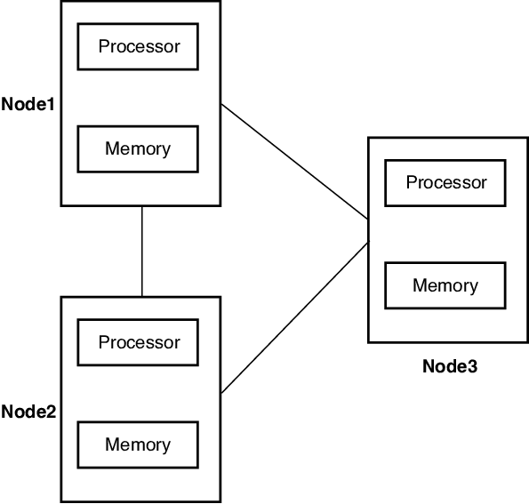
What is Distributed System?
A distributed system, also known as distributed computing, is a system with multiple components located on different machines that communicate and coordinate actions in order to appear as a single coherent system to the end-user.

Slide 5
Distributed System - Parts
Distributed system parts
Computers, physical servers, virtual machines, or any other node that can connect to the network, have local memory, and communicate by passing messages.

Slide 6
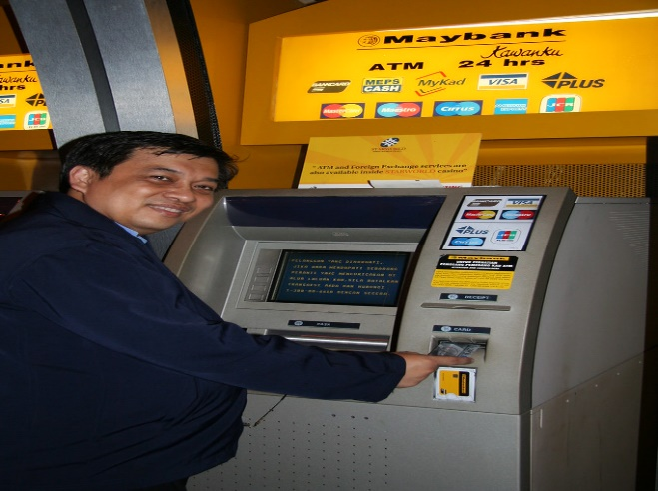
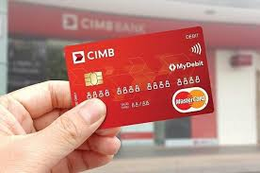
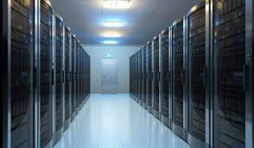

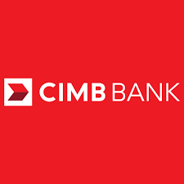
Distributed System – Example - ATM
The application that is used for coordinating this distribution system process referred to as distributed application.
DCOMS technology RMI is used for creating distributed applications

Slide 7
Distributed System - Benefits
There are three reasons that teams generally decide to implement distributed systems:
Horizontal Scalability—Since computing happens independently on each node, it is easy and generally inexpensive to add additional nodes and functionality as necessary.
Reliability—Most distributed systems are fault-tolerant as they can be made up of hundreds of nodes that work together. The system generally doesn’t experience any disruptions if a single machine fails.
Performance—Distributed systems are extremely efficient because work loads can be broken up and sent to multiple machines.

Slide 8
Distributed System - Challenges
Scheduling—A distributed system has to decide which jobs need to run, when they should run, and where they should run.
Latency—The more widely your system is distributed, the more latency you can experience with communications.

Slide 9
Distributed System – Types
Distributed systems work either on client/server or P2P models:
Client-server
Single tier - A single-tier architecture is an architecture in which the entire application resides on the user's machine.
Two tier —Clients contact the server for data, then format it and display it to the end-user. The end-user can also make a change from the client-side and commit it back to the server to make it permanent.
Three-tier—Information about the client is stored in a middle tier rather than on the client to simplify application deployment. This architecture model is most common for web applications.
Peer-to-peer—There are no additional machines used to provide services or manage resources. Responsibilities are uniformly distributed among machines in the system, known as peers, which can serve as either client or server.

Slide 10
Distributed Application using RMI
Method call
void add(2.3)
in node 1
void add(2.3)
void add(int a, int b)
{
return a+b;
}
Method definition for void add in node 2

Slide 11
Review Questions
What is Distributed Systems?
What are the parts of Distributed Systems?

Slide 12
Summary / Recap of Main Points
Introduction to Distributed System
Distributed System Parts
Distributed System Benefits
Distributed System Challenges

Slide 13
What To Expect Next Week
In Class
RMI

